Slide 1
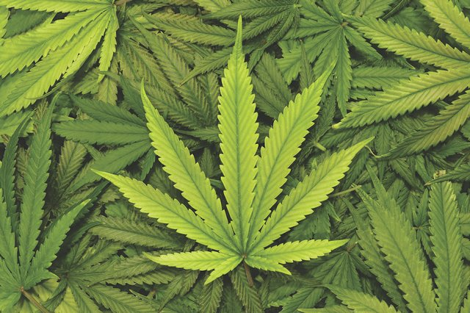
Determining Optimal Location for Marijuana Dispensary
Toronto, Ontario, Canada
Data Science Capstone
Spring 2019
Linda Dekowski Crampton

Slide 2


Background:
Marijuana is now legal in Canada. Toronto, the largest city in Canada, seems like an ideal place to open a new marijuana dispensary.
Target Audience:
Investors hoping to turn a profit on an emerging business opportunity (marijuana) in an established market (Toronto).
Business Question:
Where in Toronto is the best location for a new marijuana dispensary?
Technology
Can we mine neighborhood information using geo-info tools such as Foursquare data and AI techniques such as clustering to suggest an optimal location for the facility?

Slide 3
Research
Review of research on marijuana dispensaries suggests they are location-constrained by zoning regulations and neighborhood opposition. It is theorized that marijuana shops are often located near strip clubs, liquor stores, bars and other adult diversions due to favorable zoning regulations and tolerant neighbors.
Research shows that marijuana customers are normally higher income; however, these facilities are located in low income areas – often near the outskirts of the city limits and usually near a freeway offramp. Theory is that people don’t want to live next door to a pot shop, and don’t mind freeway driving to a seedier neighborhood to purchase product.
Reference provided near the end of presentation.

Slide 4
Data Sources
Primary data sources are Foursquare location data, Wikipdia Postal Code data, data obtained from GoogleMaps and world census data.
Census Data parsed to extract fields: PostCode, Borough, Neighborhood, Population, Longitude, Latitude, PopulationDensity, Area, SpendingPower
Data coordinates for marijuana dispensaries and strip clubs obtained via Google Maps API.

Slide 5
Postcode', 'Borough', 'Neighbourhood
Data Source – Postal Codes
Postal Codes are needed for neighborhood longitude/latitude data mapping and required to obtain venue information from Foursquare. Postal codes for Toronto, Ontario, Canada were extracted from "List of postal codes of Canada: M" (https://en.wikipedia.org/wiki/List_of_postal_codes_of_Canada:_M).
Resulting neighborhood html data parsed and fields Postcode, Borough, Neighborhood stored in a table (example below)
Data then transformed into dataframe; entries with empty fields resolved.
Postcode | Borough | Neighborhood
0 | M3A | North York | Parkwoods
1 | M4A | North York | Victoria Village
2 | M5A | Downtown Toronto | Harbourfront

Slide 6
Data Source - Foursquare
Foursquare is a location data provider. URL request (including longitude, latitude location data) sent via the Foursquare API returns local venue data, which can be mined to obtain neighborhood information.
Foursqure API query programmed to return a maximum of 200 venues within a 1000 meter radius (about 0.6 miles for those of us who are metric-impaired)
Foursquare’s free accounts are limited as to the number of queries. Rather than rerunning queries, query results data pickled, stored, and retrieved.
Foursquare query returns information on Venue, including Name, Category and Geographic Coordinates

Slide 7
Biases
Data collection for the project was affected by bias.
Although Foursquare contains venue categories for strip clubs and marijuana dispensaries, Foursquare data did not accurately report their presence. Both strip club and marijuana dispensary data was collected from Google Maps.
I believe the lack of Foursquare data for these venues was due to bias – selection bias and self-report bias.
Individuals who visit strip clubs or marijuana venues might not want to advertise these activities. Since Foursquare requires self-report, it is likely that visits to these facilities would be under-reported in Foursquare. Thus, self-report bias.
A subset of society uses Foursquare regularly. The subset of society who visit strip clubs may not be heavy Foursquare users. Thus, selection bias.
To counteract these biases, data for strip clubs and marijuana venues collected from GoogleMaps.

Slide 8
Data Cleaning, Prep, Munging
Census data scraped from Beautiful Soup
Pandas dataframes receive census, Foursquare, Wikipedia, GoogleMaps data; pandas routines drop cells with missing data and reformat data
After Foursquare Data returned for nearby venues, venues enumated and one-hot encoded
Numpy used to calculate density, relative spending power
SciPy used for Kmeans clustering

Slide 9
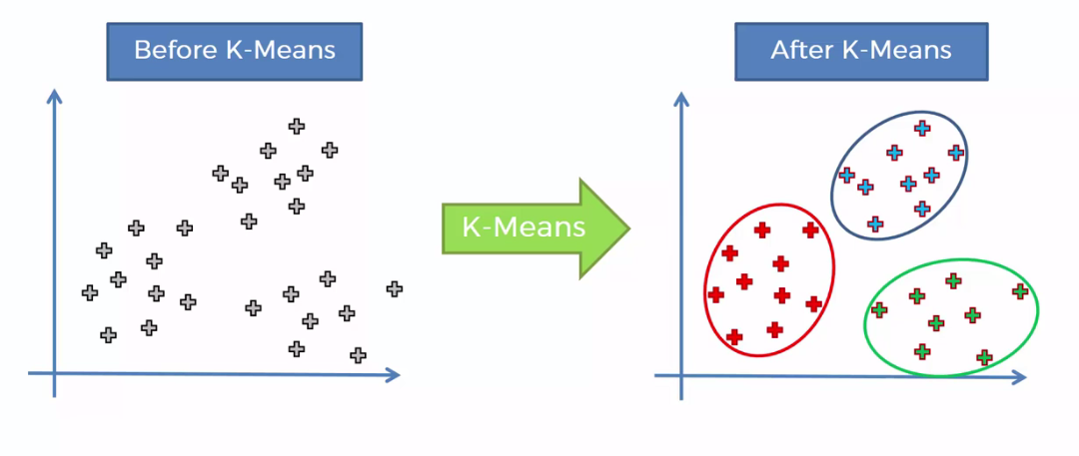
Clustering – K-means
Unsupervised machine learning algorithm K-means segregates data into a predefined number of clusters based on similarities in the datasets.
Optimal number of clusters chosen via elbow analysis. Optimal cluster size is chosen by inspecting the elbow plot and determining that adding another cluster would not offer significant improvement.

Slide 10
Folium
Python visualization library
Uses location data to create an interactive leaflet map
Displays data mined from Foursquare and manipulated in Pandas dataframes to provide information on neighborhoods, densities and locations
Clusters of neighborhoods sharing similar characteristics displayed
Point locations (of marijuana dispensaries and strip clubs) displayed

Slide 11
Visually Examining Neighborhood Characteristics
Visually reviewing neighborhood maps might provide guidance in locating the next dispensary. The human eye is capable of quickly detecting patterns, and folium maps are a great way to display the data.
Data will be displayed in Folium Maps to determine if neighborhood density, neighborhood spending power, neighborhood similarity or colocation of strip clubs can provide insight as to the optimal location of a marijuana dispensary.

Slide 12
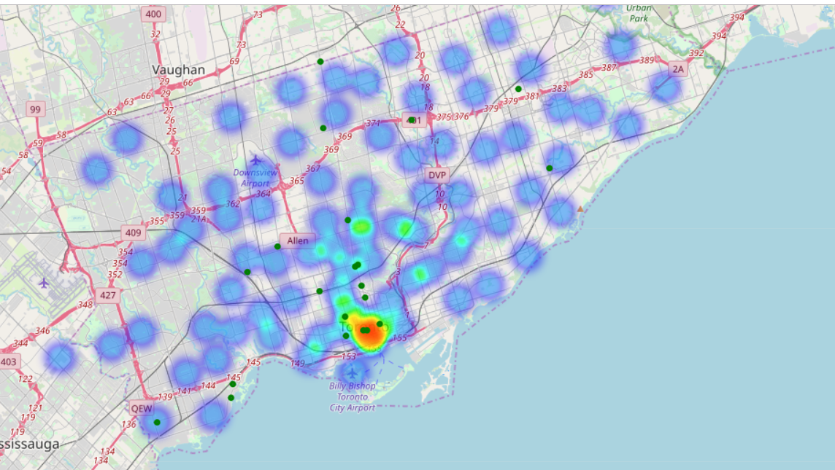
Is there a clear relationship between spending power
and local marijuana dispensaries (green dots)?

Slide 13
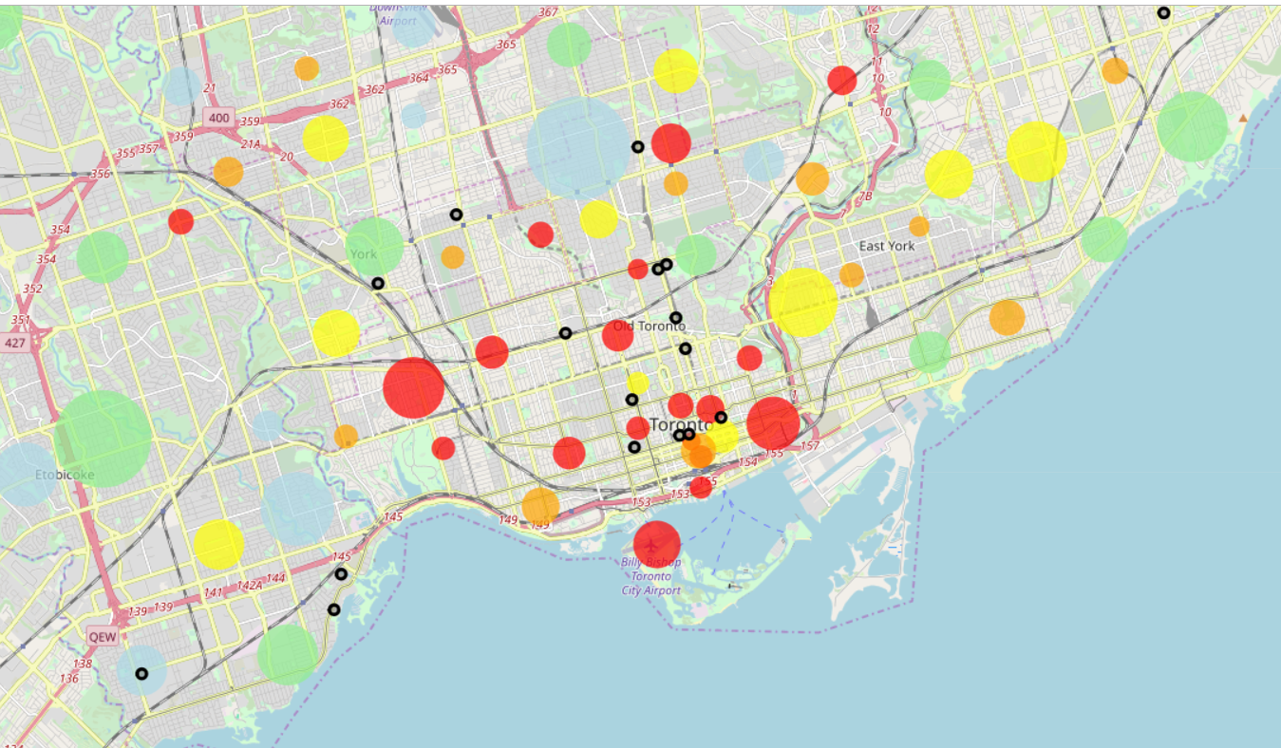
Is there a clear relationship between neighborhood density/size
and the location of marijuana dispensaries (black dots)?
Blue – least dense
Green
Yellow
Orange
Red – highest density
Circle radius indicates neighborhood size

Slide 14
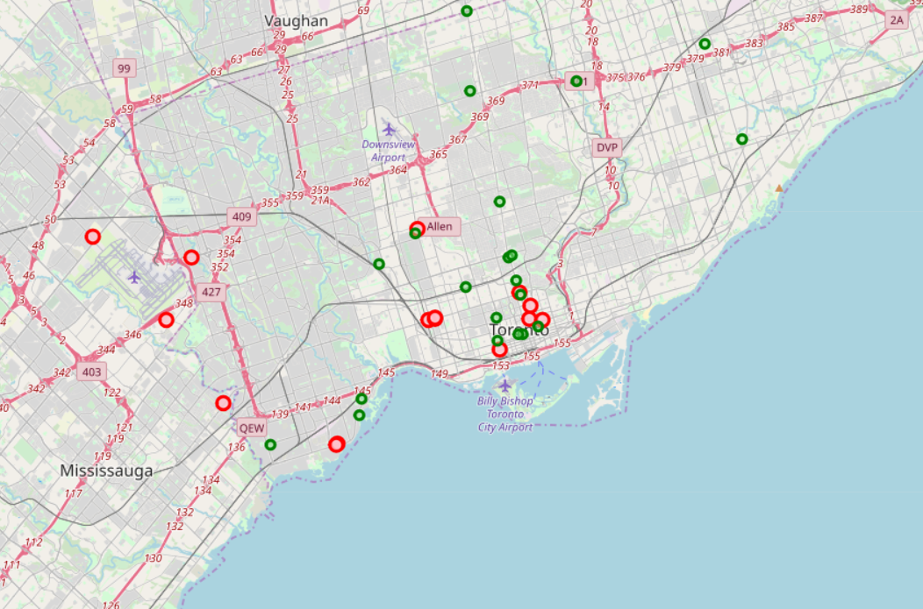
Does the location of strip clubs provide insight as to the location of marijuana dispensaries?
Research discusses marijuana dispensaries located in the vicinity of strip clubs. Google Maps API utilized to determine locations of marijuana dispensaries and strip clubs.

Slide 15
Neither neighborhood density or neighborhood spending power uniquely determines the location of marijuana dispensaries
When locations of existing marijuana dispensaries are overlaid on a map of neighborhood spending power and on a map of neighborhood density, the is no unambiguious relationship apparent.
Current dispensaries are generally in smaller (physical area), high population density neighborhoods on the lower end of the spending power range, but not all low-income, dense, small physical area neighborhoods have marijuana dispensaries and not all marijuana dispensaries are in low-income small physical area neighborhoods.
As predicted by research, strip clubs are often co-located in neighborhoods with marijuana dispensaries.

Slide 16
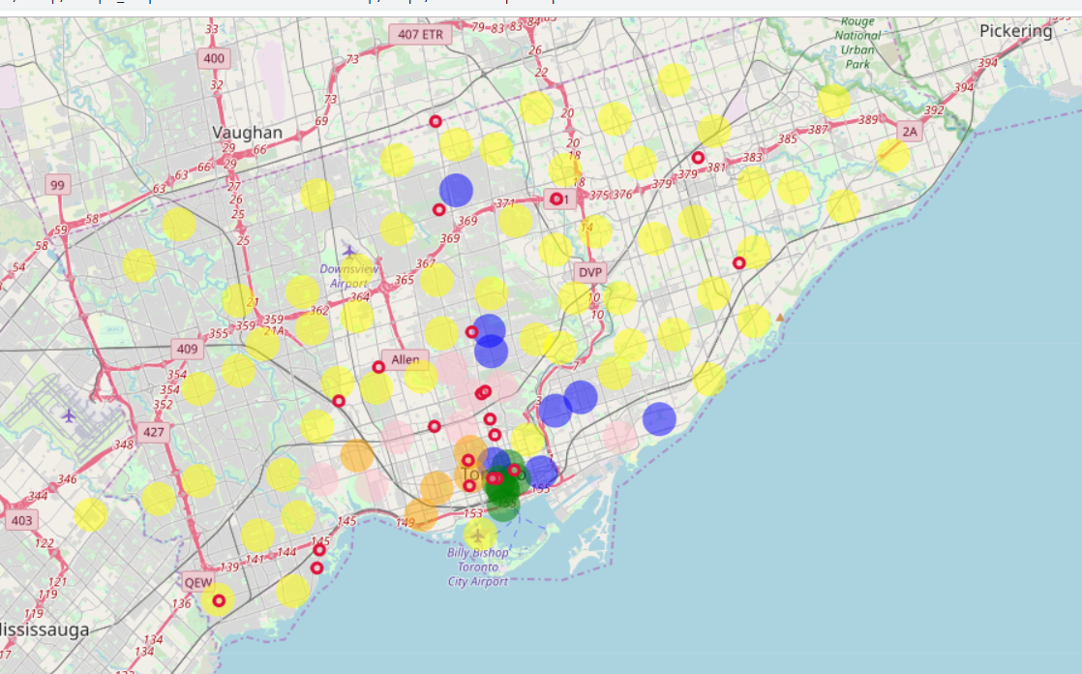
Can clustered neighborhood characteristics provide insight as to the location of marijuana dispensaries?
Kmeans clustering with 5 clusters, marijuana dispensaries displayed as red dots

Slide 17
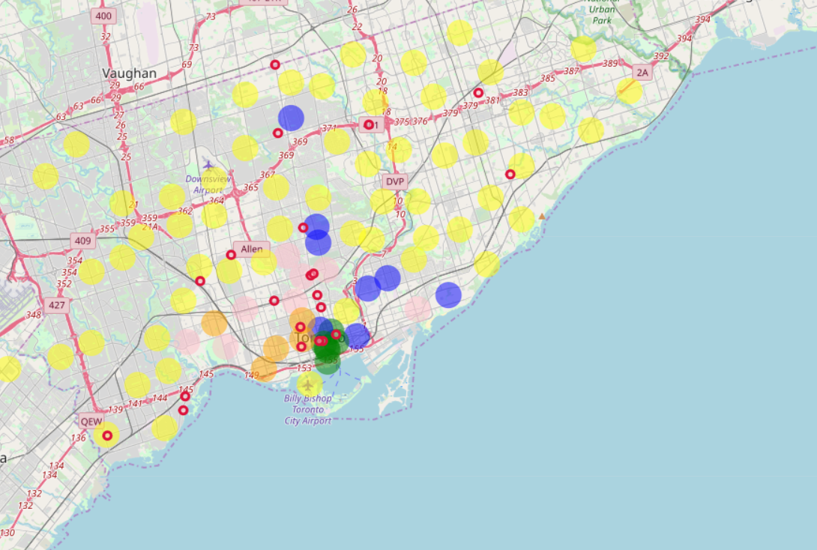
If we optimized the number of clusters, could we gain insight as to the location of marijuana dispensaries?
Clustering into 6 groups, as suggested by Elbow Analysis.

Slide 18
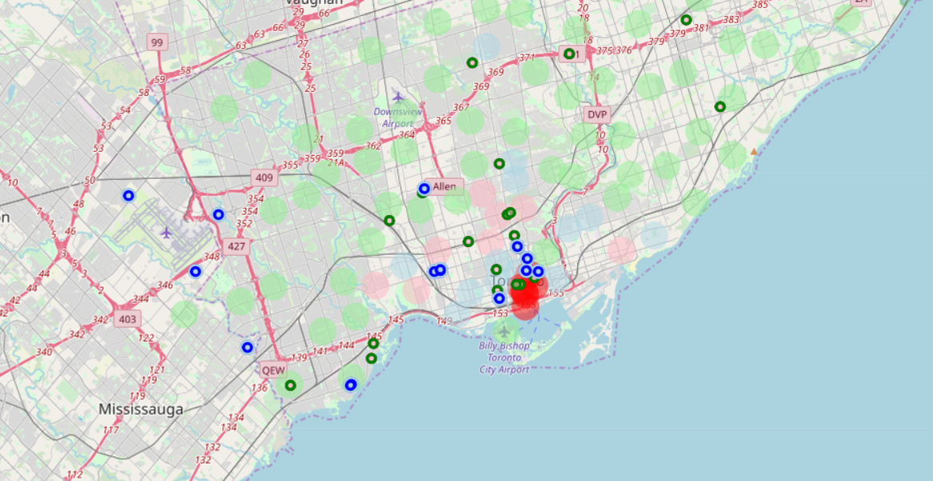
Which are the best/worst neighborhood cluster areas to locate a marijuana dispensary?
Centroids used to rank clusters for suitability; green dots mark existing marijuana dispensaries, and blue dots define strip clubs

Slide 19
Putting it all together…
Utilizing all information provided so far -- the best location for a marijuana dispensary is in a lower-income, higher density neighborhood with existing strip clubs and no existing marijuana dispensaries. Several of these areas are viewable on the previous map.

Slide 20
Opportunities for Improvement
Foursquare data, derived from self-reporting, subject to bias. Investigate other geo-locating tools.
The number of marijuana dispensaries hovers in the not-statistically significant range (~30). Further insight might be gained by examining other cities with legal marijuana (e.g, Seattle, Denver).
Alcohol venues also have a positive relationship with marijuana dispensaries. Investigate clustering neighborhoods based on percentage alcohol venues.

Slide 21
THANK YOU for your time!

Slide 22
Caveats and Disclaimers
I do not smoke or otherwise consume marijuana
I do not judge those who partake.
I have no political position or moral opinion on the issue of marijuana legalization for adults.

Slide 23
References
Dineen, J.K., "Cannabis dispensary rules in SF create clusters", San Francisco Chronicle, 10 August 2017, https://www.sfchronicle.com/bayarea/article/Cannabis-dispensary-rules-in-SF-create-clusters-11746532.php
McVey, E., "Recreational marijuana stores are clustered in low-income areas of Denver, Seattle", Marijuana Business Daily, 31 July 2017, https://mjbizdaily.com/chart-recreational-marijuana-stores-clustered-low-income-areas-denver-seattle/
Snell, R. and Beneditti, "Detroit medical marijuana shops sprout like weeds near the suburbs", Crains Detroit Business, 24 April 2016, https://www.crainsdetroit.com/article/20160424/NEWS/160429925/detroit-medical-marijuana-shops-sprout-like-weeds-near-the-suburbs
Thomas,C. and Freisthler, D., "Examining the Locations of Medical Marijuana Dispensaries in Los Angeles" Drug Alcohol Rev. 2016 May; 35(3): 334–337, Published online 2015 Sep 30. doi: 10.1111/dar.12325, https://www.ncbi.nlm.nih.gov/pmc/articles/PMC4814366/

